Slide 1


MINI PROJECT PRESENTATION
Fake News Detection using Machine Learning
UNDER THE GUIDANCE OF – Dr. Anuja Dixit

Slide 2
Team MEMBERS CSE-6D Group 10
1. VIPUL VIBHAS SINGH(20214085)
2. Vikas kumar Patel(20214084)
3. Seemant Singh(20214192)
4. SANGRAM SINGH(20214231)

Slide 3

CONTENTS
INTRODUCTION
MOTIVATION
PROBLEM STATEMENT
OBJECTIVE
RELATED WORK
Proposed work
Result analysis
Conclusion
Future scope
references

Slide 4

INTRODUCTION
In today's interconnected world, the rapid spread of misinformation and fake news poses a significant challenge to society. The ease with which false narratives can be disseminated through social media and online platforms has eroded public trust and undermined informed decision-making. This introduction explores how technology can be leveraged to detect and combat the growing threat of fake news, with the ultimate goal of promoting transparency, honesty, and a more engaged and discerning public.

Slide 5
The Motivation: Misinformation and Its Consequences
1
Undermining Trust
2
Influencing Decisions
Fake news undermines the credibility of legitimate news sources, leading to a breakdown in public trust and a growing skepticism towards all forms of media.
Misleading information can sway important decisions, from personal health choices to political outcomes, with far-reaching societal implications.
3
Fueling Divisions
4
Eroding Democracy
False stories can make people more divided and cause problems in society and politics. This can make communities split apart and harm how people get along.
Fake news spreading everywhere can hurt democracy by changing what people think and making it hard to trust how things work in a fair and free society.

Slide 6

Problem Statement: Combating Evolving Tactics
1
Rapid Spread
The widespread use of social media as a primary source of information has enabled the rapid dissemination of fake news, making it increasingly difficult to contain the spread of misinformation.
2
Evolving Tactics
Purveyors of fake news continuously adapt their tactics, making it challenging for existing detection tools to keep pace and effectively identify and debunk false narratives.
3
Overwhelming Volume
The sheer volume and diversity of fake news content further complicates the detection process, as the scale of the problem overwhelms traditional fact-checking methods.

Slide 7
The Objective: Developing Advanced Detection Capabilities
Leveraging Machine Learning
Extracting Meaningful Features
Enhancing Reliability
By applying a range of machine learning techniques, including supervised learning algorithms and deep learning architectures, we aim to develop robust models capable of accurately identifying and classifying fake news content.
Our goal is to create an advanced fake news detection system that can effectively identify and debunk misinformation, thereby enhancing the reliability of information and promoting a more informed public discourse.
Through the use of natural language processing (NLP) techniques, such as TF-IDF vectorization, we can extract meaningful features from textual data that can help distinguish genuine news from fabricated content.

Slide 8
Related Work: Exploring Existing Approaches
Supervised Learning
Deep Learning Architectures
Previous studies have explored the use of supervised learning algorithms, such as logistic regression and decision trees, trained on labeled datasets containing real and fake news articles.
Researchers have also investigated the effectiveness of deep learning models, including Convolutional Neural Networks (CNNs) and Recurrent Neural Networks (RNNs), in capturing complex relationships within textual data for improved fake news detection.
Ensemble Approaches
Improving upon Previous Work
Combining multiple models through ensemble learning techniques has shown promising results, with studies demonstrating that ensemble methods can achieve higher accuracy in distinguishing fake news from genuine content.
To further enhance the effectiveness of fake news detection, this project proposes to leverage TF-IDF vectorization, implement multiple machine learning models, and train on a larger volume of data, building upon the insights and limitations identified in prior research.

Slide 9
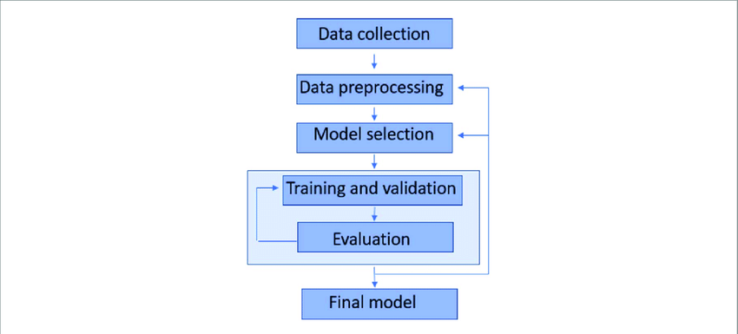
The Proposed Approach: Implementing Multiple Models
1
Data Collection, Cleaning and Transformation
The project begins with the collection and preprocessing of a balanced dataset containing both real and fake news articles. This includes removing unnecessary information, handling missing values, and converting the textual data into a format suitable for machine learning algorithms.
2
Model Training
Three distinct machine learning models will be trained and evaluated: Logistic Regression, Decision Tree Classifier, and Random Forest Classifier. Each model will be trained on the preprocessed dataset, leveraging TF-IDF vectorization to capture the importance of textual features.
3
Model Evaluation and Deployment
The performance of the trained models will be assessed using various metrics, such as accuracy, precision, recall, and F1-score. The most effective model will then be selected , enabling the detection and classification of fake news in real-world scenarios.

Slide 10
Data Cleaning and Exploration
1
Data Cleaning
During the data cleaning phase, in addition to removing the ID and URL columns, any empty or problematic rows are rectified by replacing them with a space (' ') which allows us to not drop any data from the dataset.
2
Data Exploration
Following data collection, data exploration serves the purpose of understanding the characteristics and identifying patterns within the dataset. This process helps mitigate the risk of having severely imbalanced data, which could significantly impact the model trained in subsequent stages. The exploration reveals that the dataset is well-balanced, with 35,029 entries labeled as "0" (fake news) and 37,105 entries labeled as "1" (real news).

Slide 11
Data Preparation and Transformation
3
Data Preparation
Data preparation is a critical stage where the data is transformed into a format that the machine learning model can understand and use for training. This includes removing special characters, converting to lowercase, and removing stop words to focus the model on the most relevant features. Stemming is also performed to consolidate words with the same root, providing a more thorough analysis of the frequency of key terms.
4
Data Transformation
To make text understandable for machine learning, we turn it into numbers. This process is called feature extraction or vectorization. TF-IDF is one way to do this for text. It changes each piece of text into a number vector. In TF-IDF, each word gets a score based on how often it appears in a document compared to how often it appears in all documents. Words that show up a lot in one document but not in many others get higher scores. This helps machines understand which words are important in each document and across all documents. TF-IDF has two parts: TF (Term Frequency) measures how often a word appears in a document, and IDF (Inverse Document Frequency) measures how rare a word is across all documents.

Slide 12



Model Training
Logistic Regression
Decision Tree
Random Forest
Logistic Regression is a linear model used for classification tasks, where it predicts the probability of a binary outcome. It works by fitting a logistic function to the training data to make predictions based on input features.
Decision Tree Classifier is a non-linear model that makes decisions by splitting the data into branches based on feature values. It recursively partitions the feature space into subsets that are more homogeneous with respect to the target variable.
Random Forest Classifier is an ensemble learning method that builds multiple decision trees and combines their predictions.
It improves upon decision trees by reducing overfitting and increasing accuracy.

Slide 13
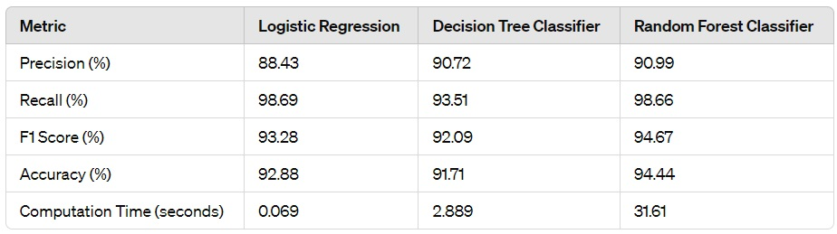
Model Evaluation
Logistic Regression
Decision Tree
Random Forest
Logistic Regression demonstrated high recall and respectable precision, resulting in a balanced F1 score and accuracy. With remarkably low computation time, Logistic Regression is an optimal choice when computational efficiency is paramount
The Decision Tree Classifier, while exhibiting slightly lower recall than Logistic Regression, maintains good precision and a moderate F1 score. computation time than Logistic Regression
The Random Forest Classifier outperforms the others in terms of precision, recall, F1 score, and accuracy, albeit at the expense of significantly higher computation time.

Slide 14


Logistic Regression: Efficient and Balanced
Computational Efficiency
Balanced Performance
High Recall
Logistic Regression exhibits a high recall, ensuring that a larger proportion of fake news articles are correctly identified.
Logistic Regression is a computationally efficient model, making it suitable for scenarios where quick predictions are required.
The model demonstrates a good balance between precision and recall, making it a reliable choice for detecting fake news.

Slide 15
Decision Tree Classifier: Interpretable and Versatile
Interpretability
Handling Diverse Data
Moderate Performance
The Decision Tree Classifier offers a high degree of interpretability, making it easier to understand the decision-making process and the factors contributing to the classification of fake news.
The Decision Tree Classifier can effectively handle both categorical and continuous data, making it a versatile choice for a wide range of fake news detection scenarios.
While the Decision Tree Classifier may not outperform other models in terms of overall accuracy, it maintains a respectable balance between precision and recall, making it a suitable option when model transparency is a priority.

Slide 16




Random Forest Classifier: Maximizing Accuracy
Ensemble Approach
Robust Performance
Computational Tradeoff
The Random Forest Classifier is an ensemble method that combines multiple decision trees, leveraging the collective strength of the individual models to enhance the overall accuracy of fake news detection.
The Random Forest Classifier consistently outperforms the other models in terms of precision, recall, F1-score, and overall accuracy, making it the optimal choice when maximizing the detection of fake news is the primary objective.
The increased accuracy of the Random Forest Classifier comes at the cost of higher computational time, as the training and prediction processes involve the aggregation of multiple decision trees.

Slide 17
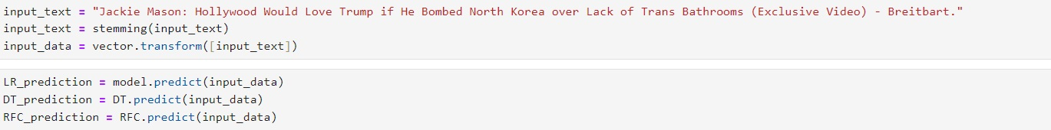
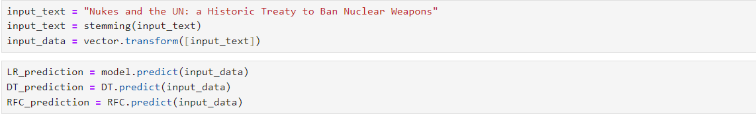
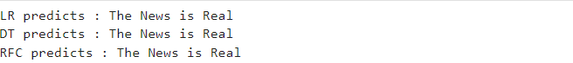
Result Analysis
1
Tailored Models by Genre
2
Advanced Feature Creation
Input News
Output
3
Continuous Dataset Growth
4
Input News
Output

Slide 18
Conclusion
In summary, the top-performing model in this project achieves an impressive accuracy of 94.44% and a high recall rate of 98.66%, ensuring accurate detection of fake news with minimal errors.
By leveraging TF-IDF, which considers both term frequency and the importance of terms, the model prioritizes key information.
Logistic Regression model is well-suited for social media platforms, where rapid responses to updates are crucial due to their quick computation time and low error rates.
Conversely, Random Forest model offering higher accuracy and recall, are preferable for platforms with less urgency in updating feeds, ensuring effective detection and prevention of fake news dissemination.

Slide 19
Future Directions
1
Tailored Models by Genre
2
Advanced Feature Creation
Developing separate models for different news genres can improve the accuracy of fake news detection across diverse topics, addressing the nuances and unique characteristics of various content types.
Exploring the use of more sophisticated natural language processing techniques and incorporating additional contextual features can further enhance the models' understanding of news content and improve their ability to distinguish fake from genuine information.
3
Continuous Dataset Growth
4
Practical Application
Implementing the developed models in real-world organizations and platforms can help detect and prevent the spread of false information, thereby maintaining trust, credibility, and transparency in digital communication.
Expanding the dataset with news articles from various languages and sources will ensure broader coverage and better model generalization, enabling the detection of fake news across diverse cultural and linguistic boundaries.

Slide 20
References
1. A. S. A. Ahmed, A. Abidin, M. A. Maarof, and R. A. Rashid, ”Fake news detection: A survey,” IEEE Access, vol. 9, pp. 113051-113071, 2021. doi: 10.1109/ACCESS.2021.3104178
2. M. F. Hossain, M. M. Islam, M. A. H. Khan, and J. J. Jung, ”Fake news detection using hybrid machine learning algorithms,” IEEE Access, vol. 8, pp. 233350233364, 2020. doi: 10.1109/ACCESS.2020.3041149
3. S. Asghar, S. Mahmood, and H. Kamran, ”Fake news detection using machine learning: A survey,” IEEE Access, vol. 9, pp. 57613-57639, 2021. doi: 10.1109/ACCESS.2021.3075392
4. J. Brownlee, ”Machine Learning Mastery,” 7 December 2018. [Online]. Available:https://machinelearningmastery.com/earlystopping-to-avoid-overtraining-neural-network
models/. [Accessed 23 November 2019].
5. Pearson’s Machine Learning by Saikat Dutt, Subramanian Chandramouli and Amit Kumar Das

Slide 21

THANK YOU

